Slide 1
JPEG Image Compression Standard
Introduction
Lossless and Lossy Coding Schemes
JPEG Standard Details
Summary

Slide 2
Need for Compression
Multimedia data need
  Huge storage space
  Large Bandwidth for transmission
Storage, Bandwidth Requirements are usually much greater than availability
Compression is viable technique

Slide 4
JPEG Image Compression Standard
JPEG : Joint Photographic Experts Group
Standard for continuous tone still images
Widely used standard
New Standard : JPEG 2000 (being worked out)‏

Slide 5
JPEG Components
Hybrid Technique: User Several Coding Techniques
DCT Coding
Run Length Encoding(RLE)‏
Huffman Coding

Slide 6
JPEG Modes
Four Modes:
Lossless JPEG
Sequential (Baseline) JPEG
Progressive JPEG
Hierarchical JPEG

Slide 7
Lossless JPEG
Uses Linear Predictive Technique
Provides 8 prediction schemes
Residual Image derived from original and predicted images
Residual Image encoded using Entropy coding

Slide 9
Baseline JPEG
Level-shift the image is by subtracting 2^{n-1} from each pixel value, where n is the number of bits used to represent each pixel
Divide the image into non-overlapping blocks of size 8 x 8
Apply DCT to each of the blocks to obtain the transform coefficients
Quantize the coefficients using a table specified by the standard, which contains the quantizer step sizes
Order the quantized coefficients using the zigzag ordering
Encode the ordered quantized values using a variable bit length entropy coder (Huffman coding tables)‏

Slide 10
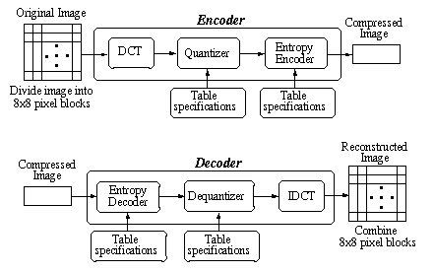
Baseline JPEG encoding and decoding

Slide 11
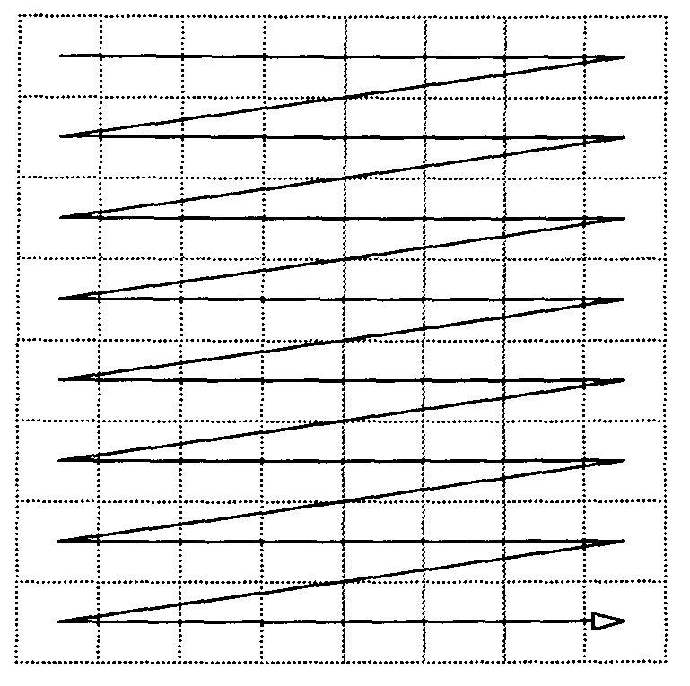
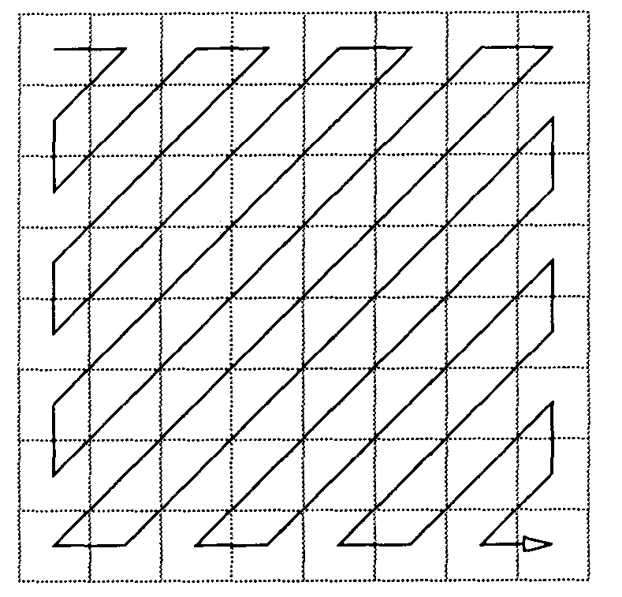
Conventional and zig-zag ordering in an 8x8 matrix

Slide 12
Baseline JPEG
DC Coefficient :
  First coefficient in every 8 x 8 block
  Represents the average value of pixels in block
AC Coefficients : Remaining 63 coefficients in every 8 x 8 block
DC Coefficients: treated separately from the AC Coefficients
Differential values of DC coeffs. of all blocks are derived and encoded

Slide 13

DC Coefficient Encoding
8 bit/pixel DC Coefficient range : 11 bits
Differential DC value range : 12 bits
Category Table for differential DC values available
12 entries in category Table
SSSS : index to category table for differential DC values
Huffman Table available for SSSS

Slide 15

DC Coefficient Encoding
Form Differential DC coefficients, D_{i}
For each D_{i} determine SSSS
Relative Magnitude of G_{i} within the category : M_{i}
Determine Sign : G_{i} =1 if D_{i} 0; G_{i} = 0 if D_{i}<0
Lookup code for SSSS in the Huffman Table, (say V_{i})‏
Form V_{i} . G_{i} . M_{i} ( ‘.’ : concatenation)‏
Encoding of D_{i} : V_{i} . G_{i} . M_{i}

Slide 16
AC Coefficient Encoding
Category Table for AC coefficients available
Huffman Table for category numbers available
Express non-zero AC coefficients as : NNNNSSSS
NNNN : Runlength, R
NNNN : Number of zeroes between previous and current non-zero AC coefficients
Runlength 16 : 11110000
Runlength >16 : qr , where q = Rdiv16 ; r=Rmod16
SSSS : Index into Category Table

Slide 18
AC Coefficient Encoding
16 possible Run Lengths (0-15) : NNNN
10 categories for AC values : SSSS
Two special codes:
  Runlength of 16 : 11110000
  End of Block (EOB) : 00000000
Huffman Table Size : 16 * 10 + 2 = 162

Slide 19
AC Coefficient Encoding
Express AC coefficients A_{i} as NNNNSSSS
Determine V_{i} the Huffman code corresponding to NNNNSSSS
Determine M_{i} : relative magnitude of A_{i} within the category
M_{i} = (k-1) bits of the 1’s complement of A_{i}
k : category number
Sign G_{i} : 1 if A_{i} 0; 0 if A_{i}<0
Encoding of A_{i} : V_{i} . G_{i} . M_{i} ( ‘.’ : concatenation)‏

Slide 20
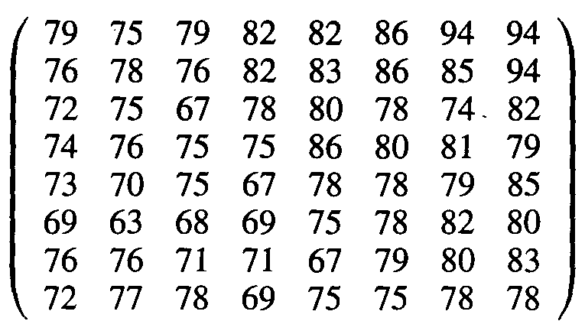
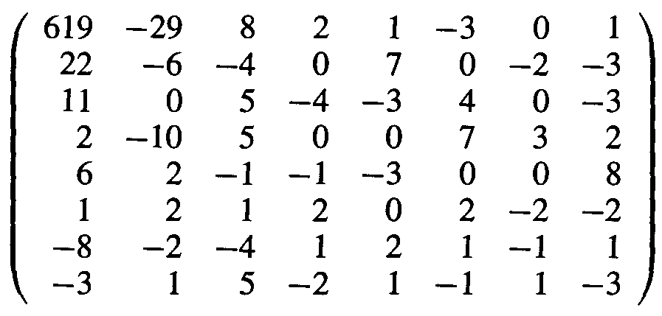
Example
X =
Apply 2-D DCT
Y =
Quantize

Slide 21
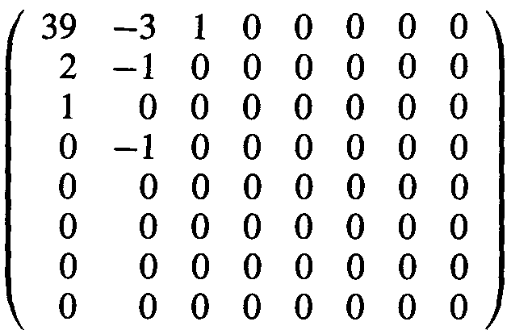
Example (Contd.)‏
Z =
ZigZag Ordering
(39 –3 2 1 –1 1 0 0 0 0 0 –1 EOB)‏
Huffman Encode
(100101/0100/0110/001/000/001/11110100/1010)‏

Slide 22
Progressive JPEG
Formation of coefficients and Quantization similar to Baseline JPEG
Each coefficient coded in mulitple scans
Each succesive scan refines Image
Two types:
  Spectral Selection
  Successive Approximation

Slide 23
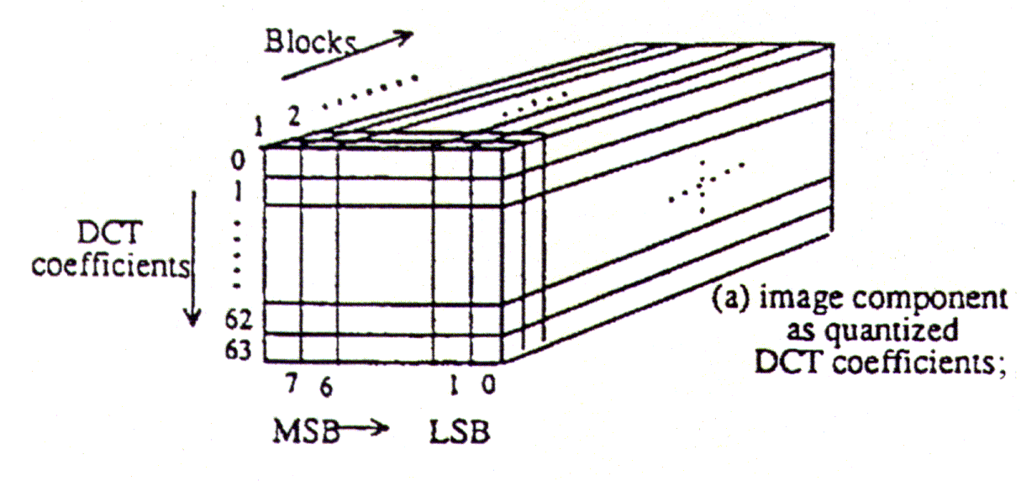
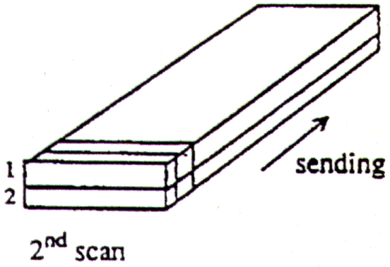
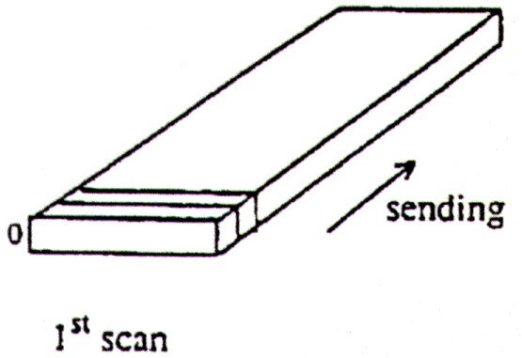
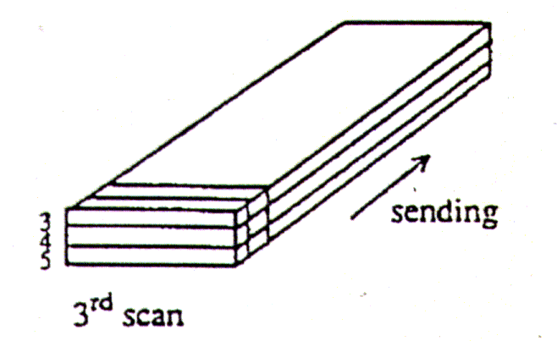
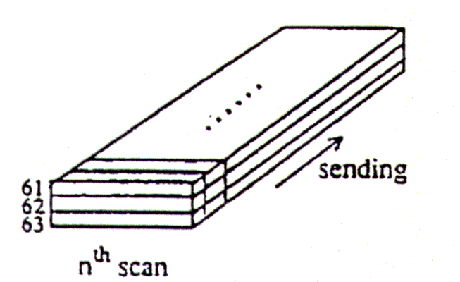
Progressive: Spectral Selection

Slide 24
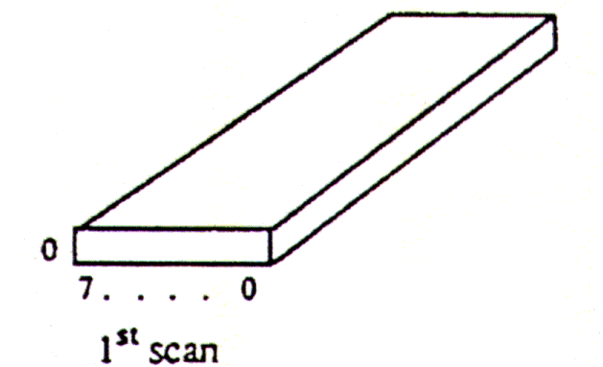
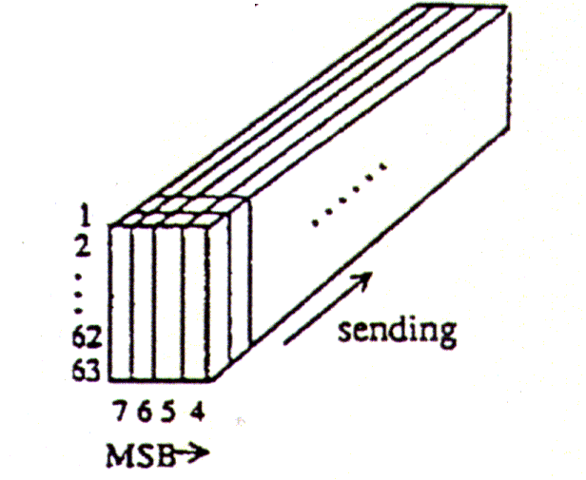
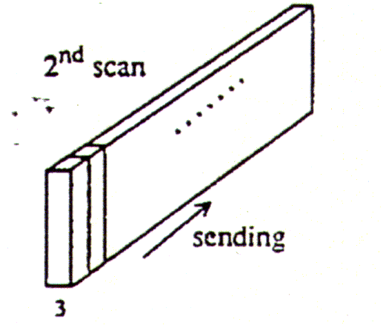
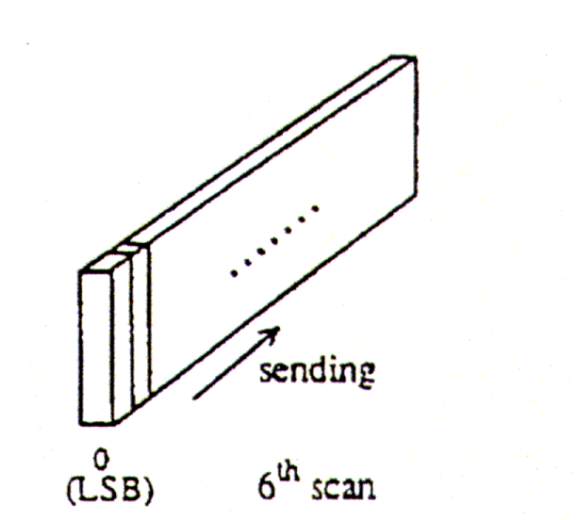
Progressive: Successive Approximation

Slide 25
Hierarchical JPEG
Provides Progressive Representations
Provides Multiple Resolutions
Requires more space

Slide 26
Hierarchical JPEG Outline
Filter and down sample the original image by the desired number of multiples of 2 in each dimension
Encode reduced-size image using either sequential DCT: progressive DCT , or lossless encoders
Decode this reduced-size image and then interpolate and upsample it by 2, horizontally and/or vertically, using the identical interpolation filter which the receiver (decoder) will use.
Use the obtained upsampled image as a prediction of the original, and encode the image difference (error) using one of the encoders
Go to Step 1 until the full resolution is encoded

Slide 27
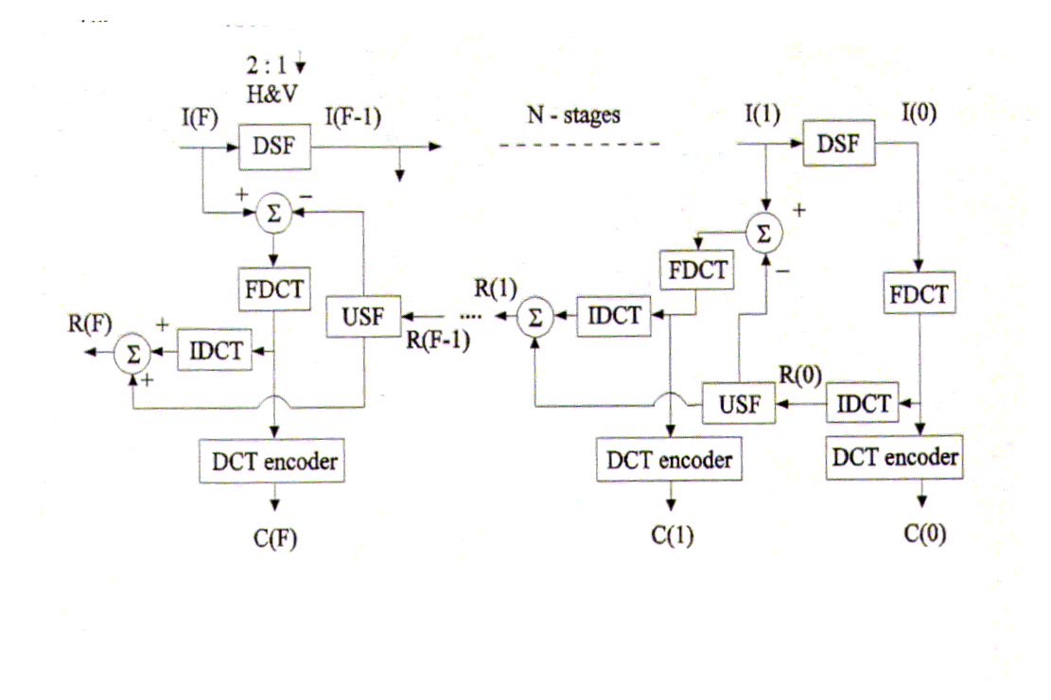
Hierarchical Encoder

Slide 30
Summary of JPEG Modes
Lossless Mode
  Coding: Predictive, sequential.
  Resolution: From two bits per pixel to 16 bits per pixel
  Huffman coding or arithmetic coding; four DC tables.
  Interleaved and noninterleaved scans.

Slide 31
Summary of JPEG Modes(Contd.)‏
Baseline Mode
  Coding: DCT-based, sequential, one to four color components.
  Resolution:eight bits per pixel.
  Huffman coding; two AC and two DC tables.
  Interleaved and noninterleaved scans

Slide 32
Summary of JPEG Modes(contd.)‏
. Progressive Mode
  Coding: DCT-based, progressive.
  Spectral selection, Successive Approximation.
  Resolution: 8 or 12 bits per pixel.
  Huffman coding or arithmetic coding; four AC and four DC tables.
  Interleaved and noninterleaved scans

Slide 33
Summary of JPEG Modes(contd.)‏
Hierarchical Mode
  Coding: DCT-based or lossless process.
  Multiple frames(non differential and differential).
  Interleaved and noninterleaved scans.

